Slide 1

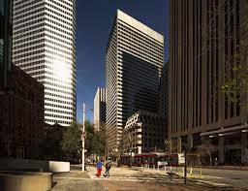

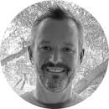
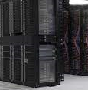
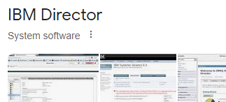
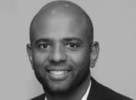
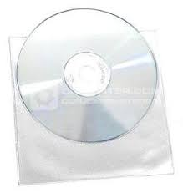
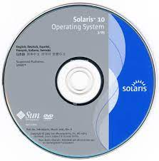
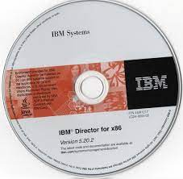
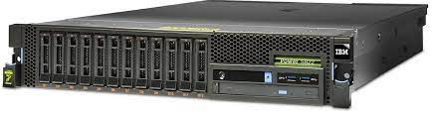
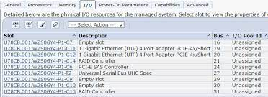
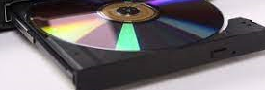
FBI
Partner
Development
2005
!apple.greenstamps.touch
FBI:WMD for North Korea
Phil(kim).tatoo
!kari
Dictatator
Bald/bald
Remote
Installation
AIX $24,000 Hardware
IMPORT SQ.☼.CDCR.MATHEW
poralce pillat data: “view; valley view”
Police Sirens: 5:02PM
Police Sirens: 4:40PM
Police Sirens: 4:26PM

Slide 2
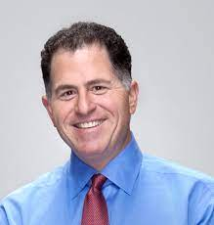
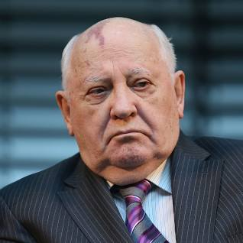
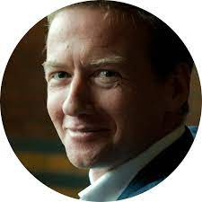
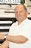
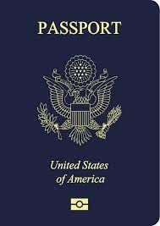
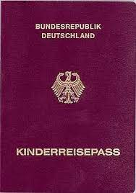
FBI
Partner
Development
2005 000.MLK(marx.SCRERN.ss)
2010 Gorbache(dell, quest.client.vodaphosne; south afirca)
quest emea ceo Henrik Jorgensen
FBI:WMD for Iran
South Africa Govment
a four-year stint in South-Africa where he worked for the South-African government
2005->2010 000.marx.SLIDE-1
Polic Sirens:
Monitoring 2010 Cyanea/WSAM 2005
- King Arthur
- South Africa; Donovan Stevnews
IMPORT Port MIAMI thomas-is-dieter(bagley)

Slide 3
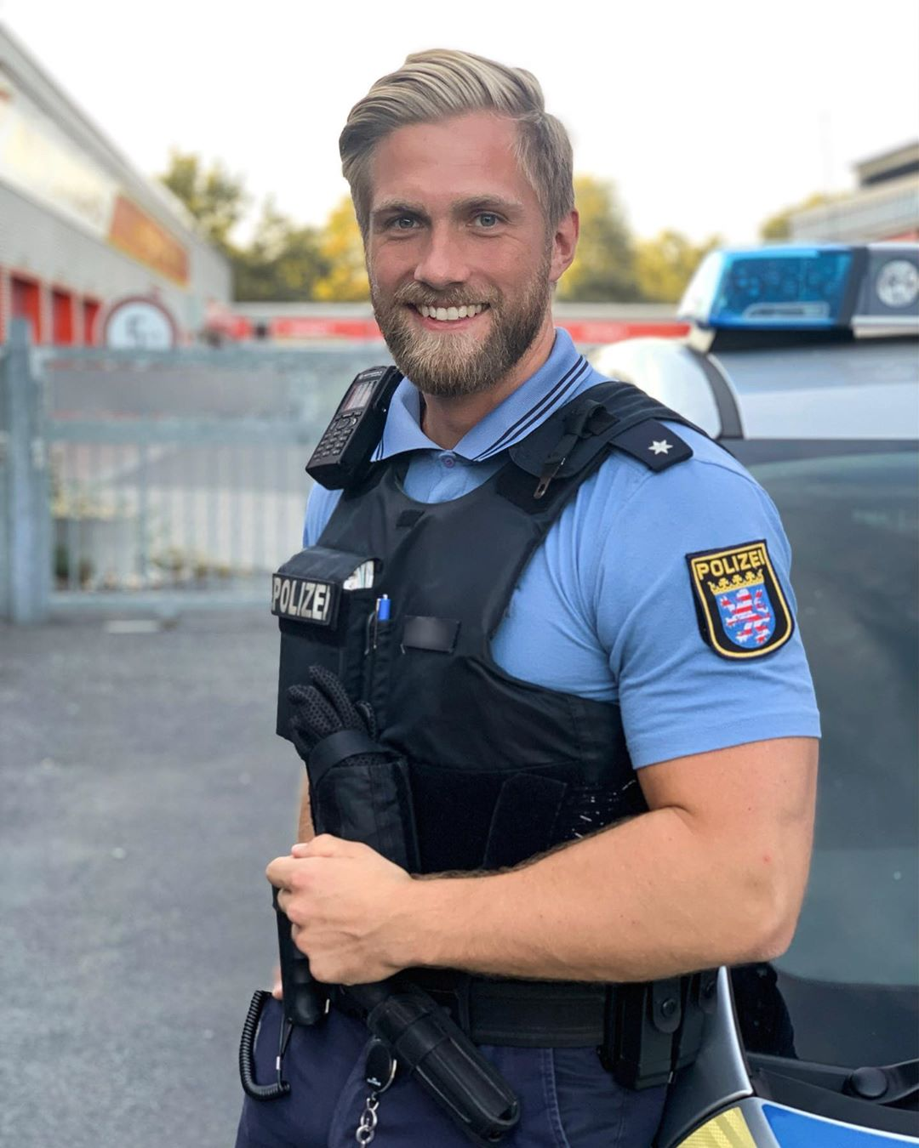
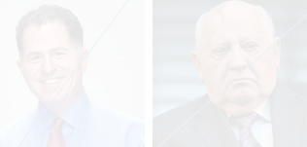
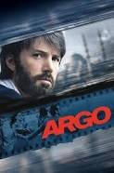


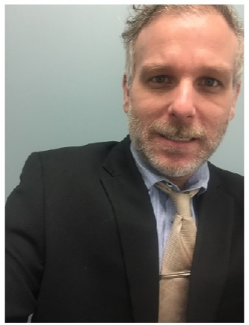
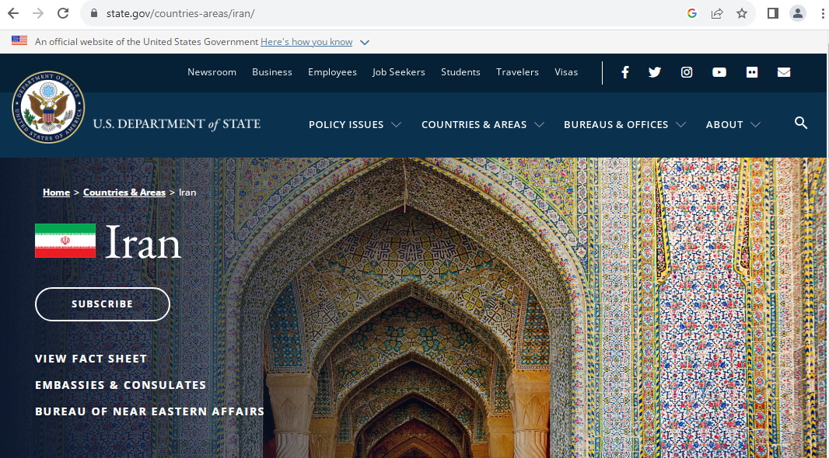
FBI
Partner
Development
SALES: toad(tranl) DEAD or
Oracle Frog Software
Quest Software Consultant
FRA to IKA
[x] no
FBI:WMD for Iran and Germany
Police Sirents: 4:53PM
Level 4: Do Not Travel

Slide 4
FBI
Partner
Development
Studio Line, Studio 54
Studio Line: WWI.”tootsie”: Stew, Stew – Studioline
Stew, Ste Sstuo form Loreal
WAR
Krieg Strasse
VIRGINA: Studio 54: Dumb cowboy

Slide 5
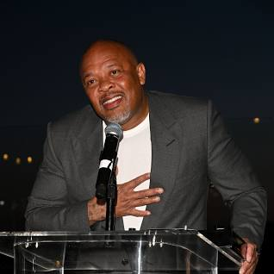
FBI
Partner
Development
Other:
IMPPORT Port MIAIAM thomas-is-dieter(bagley)
Polic Sirenst: 5:04PM

Slide 6


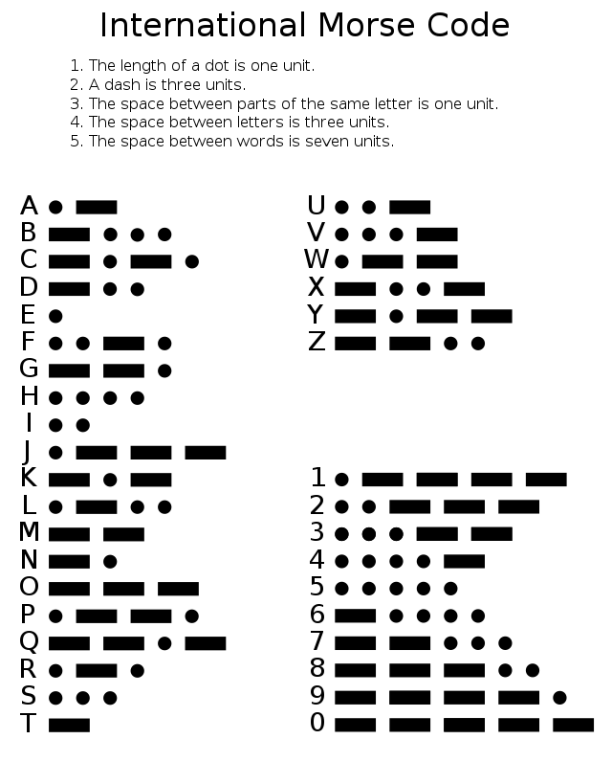
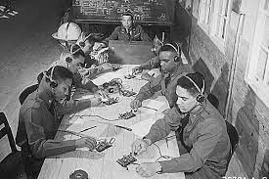

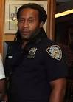
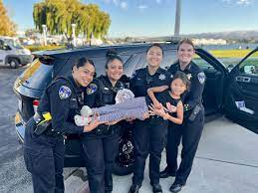
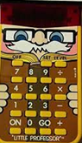
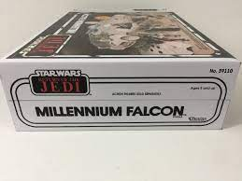
FBI
Partner
Development
nonPoliceCfgLogical
Morris
!Hatecrime §422.6
Chinse kid under chirmas tree LINCOLN.INTENTPAYMENTS.employee.JOHN O
41.apple.tango.touch.qa.St. Nick.marx
!AVAIBLTITY -> QA. (dev-ops-CICD).CPVA.
austomted builds St. Nick.”Adams”

Slide 7
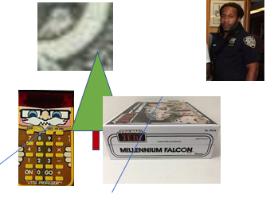
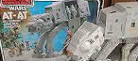
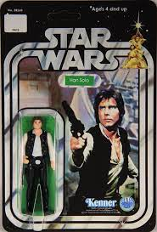
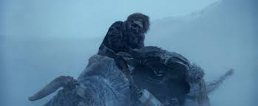
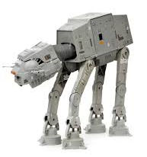
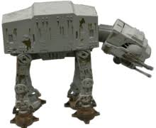
FBI
Partner
Development
Shared St. NickINT.
Santa Cruz, Zyante
1986/7
han solo action figure
LUKE(4:2)
Firetruck 0.1 fine Sound
nonPolcieHomelessLiasoin.nonPocliMG.roth.*(frauehoffer framebuffer)
Starware cut open cadaver in snow
1983/4
0.1 MATHEW: I found this
41.IPX.INT
HOMCIE:IS-A-BELL(soviet union)
HOMICIDE:JESUS
HOMCIE:TRANSVESTITE
HOMICIDE:PETER(self inflicted; !sucidie: drunk walk)
1983/4
VIRIGNA MARY (CRITIAN) ATOMCLOI(what time is it?)
CITY HALL.HOMCIE:JEUSE(CHRISTIAN NEES)
IMPORT CITY HALL SAN ANSELMO HOCMEI:JSUESE:CHRISITAN FRANKLIN)
CITYHALL Gorbache(Unimog,michelbach)
Peak Soviet Contsitn Atombomb
Comtperu 5:21 §Public Disrubance drink my shit VIRIGNA.ibm.client.sephora.HOMCEI:TRANVESTITE

Slide 8
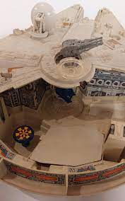

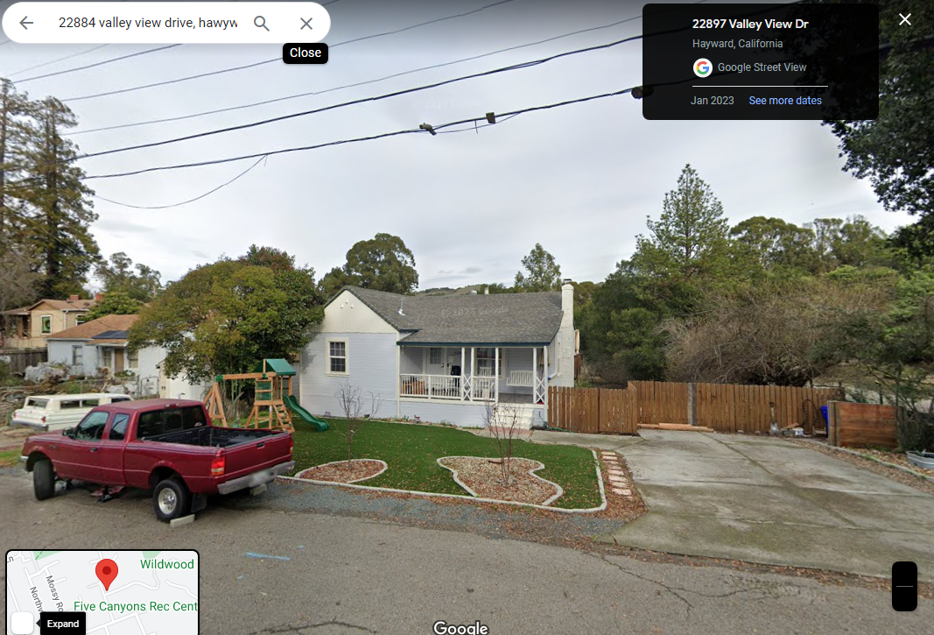
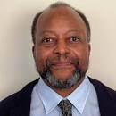

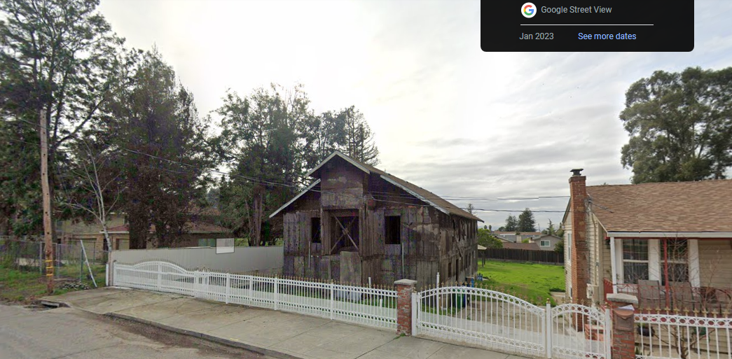
FBI
Partner
Development
SQ.AIRFILED.COLEMAN.INT
Valley View Road
“View”[].roth
“View”[22884].roth
ATOCMLCOK(G.GOD.CPVA.marx(touch))
MORGAN (trnal) “Tomorrow”

Slide 9
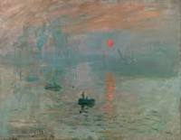

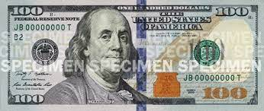

FBI
Partner
Money
Development
1986/7
MARLIN BLVD
HOMCEI:NANA.INT
ART
v1.FBI:KIDNAPPING: ATOMCLOCK(ransom)
V2.FBI:KIDNAPPING: ATOMCLOCK(ransom)
1990(1976) 4:1 DM
INT

Slide 10

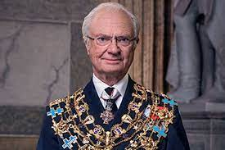
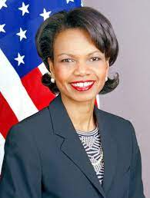
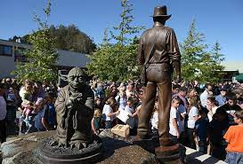
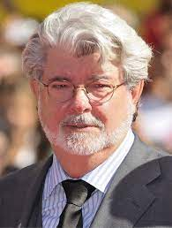
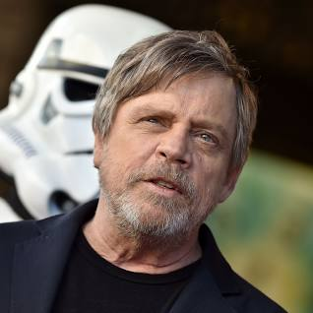
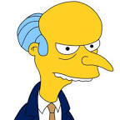
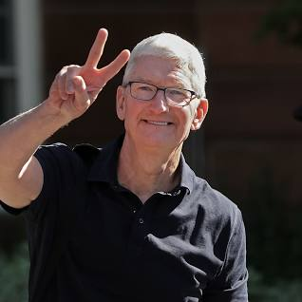
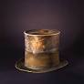
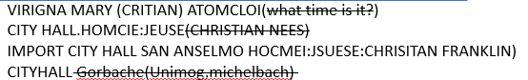






FBI
Partner
Development
!sleeping in front
LEVEL:
Police Sirens: 5:56PM
DIRECTOR.VIRIGNA.SWORN
ANGELA.BABY.BENZ AND DR SOCCER
G.God.St. Franco.Angela.8th.floor
Take off you hat
0.1 al Kaida:HOMICIDE:2Y
Pentagon.Virgina.Mary.Cherrytree
HOMCIE:LUX:CONWONT:MATHIAS: COURT LUXEMBURG (FEDERAL BANK)
9-1-1 Matthias Kraft (Dr. Dieter Zetsche)
9-1-1
0.1 What od you want? PRICE:JR:LARRY
Christian Nees
41.CAR.Thomas-is-dieter(nees).IPX
HOMICIDE:MAYOR.delta).calc(self inflicted) or Of old age
Other:
Police Sirens: 6:06PM
nonPoliceCfgLogical.HOMCEI:MANYRO.INT(SF)
extoring yang.parigin.al zollar Tiberoun.Black.Piano.Pting IPX roman baths

Slide 11












FBI
Partner
Development
1986/7 Saturday 1st, 3rd Week 6AM
Marlin Blvd
0.1 HOMCIDE:NANA
6AM Cartoons
$6 Billion
Dollar Man
1990 CHECKPOINT CHARLIE
Logical 1991 SFO->FRA Tranlate{ VIRINGA.MARY -> spy ricardo(books) DDR}
Heusenstammeralle
Homeboy
ATB
Shad Park
3-Days
Rembrücker Str. 15. 63150 Heusenstamm. Germany.
DEA(apple.crack.craig.Kenny)
INT.IPX.HOMICIDE:GHOST(Bejamin)
IPX soviet union; ddr
HOMICE:LUX(banjamin), Homicdie:IS-A-BELL( ? )
SQ.CDRD.”Pope.St.Fracis:FRANC/CRAIG”
ATOMCLOCK(“Testing with Death”)
Police Sirens: 6:23PM

Slide 12





FBI
Partner
Development
Br
1996 3PM Saturday
Marlin Blvd
Rules:
Scratch, Don’t Scratch
0.00001 implicit: don’t scratch
!raik.!pool
Police Sirens: 6:31PM
VIRGINA.ibm.ipx.damiler FBI:WMD for CAMP DAVID
Bradley Johnson
“Matinee”

Slide 13


FBI
Partner
Development
Br
“Cronicle”
Marlin Blvd
Saturday 1:30pm
Sunday 3:00pm
“Matinee”
MATHEW(4)

Slide 14

FBI
Partner
Development
Br
“Cronicle”
Marlin Blvd
Saturday 1:30pm
Sunday 3:00pm
“Matinee”
MATHEW(4)

Slide 15






FBI
Partner
Development
1986/87
Saturday 1:30pm
Sunday 3:00pm
Br
Grobachev(
roth
Marlin Blvd
Duo: No more money, left
x/y calc $40-($5x3),$20 videogmaes
“§Theft”
x
2013?
MATHEW(4)
IMPORT twins CIA.McCarthy
Phil.JFK.MLK (kick the dog)
!
2013?
x
Where is money?
41.NAMCE CHEN.CPVAlsint( I dontwant to move out)
1x nonPolciePunisment(SPANKING)
If papa gets up, gets upset
0.1 apple.touch. Snowden(kurt berger[0] Hawaii 2007 matenni gheoh(whos is god? (heberwe micehala)

Slide 16
FBI
Partner
Development
Br
“Cronicle”
Marlin Blvd
Saturday 1:30pm
Sunday 3:00pm
“Matinee”
MATHEW(4)

Slide 17







FBI
Partner
Development
41.WW2.ATB
v2.FBI:KIDNAPPING:HOMCEI:7Y.DEA(mdma).VP GERMANY
!blond
0.1 yoke-er: origami, Gary Johnson
!blond!
2015 July
Police Sirens: 7:14PM

Slide 18








FBI
Partner
Development
Decoto Road
2005
2019
FBI: Deparment of Food
ID:21:POLICE:FBI
Brown Houses
assuemd:girlfriend:crush:assuemd
ATOMCLOCK(O5,
IPX.INT CPVA.danile cherrytre v2.FBI:KIDNAPPING 1st grade photo backup (gheoh(dr, gabirl DEA(joint, default school present “schultuete” Tuete)

Slide 19













FBI
Partner
Development
1987 March 31st Easter (Sunday)
Marlin Ave.
LACE
2013 Fugessorn
2017 Robert, SavvyMoney
Police Helicopter: 7:27PM
Hudson Ct.
1990
!IMPORT dr TORT-3
HOOVER(JFK,bob)HOMCIE:DOG:
1988 Dr. Dr. Prof. Joe
Chart
Init.Oralce.Yang(INTERUTP)
Mother: Joe’s Father is Mayor of St. Peter
41.?
Pope.St. Peter-Ording(DR[] Director)
Police Sirens: 7:28
HOMICIDE:MAYOR(dr-TORT-3)
HOMCIE:NANA:MATHEW(Gameboy:Gorhceov.tetris)

Slide 20






FBI
Partner
Development
30Y CHECKPOINT CHARLIE
ATOMBOMB(DR)
!POT(DAM) Son of 0.1 Lifes a Bitch --Mother
https://www.fortworthtexas.gov/Home
2014 ATOMCLOCK
41.HOCME:MAYRO mayors son CIVIL CODE
Jürgen Ritter
dr
2016 ATOMCLOCK
MAYOR’S Son

